Slide 1
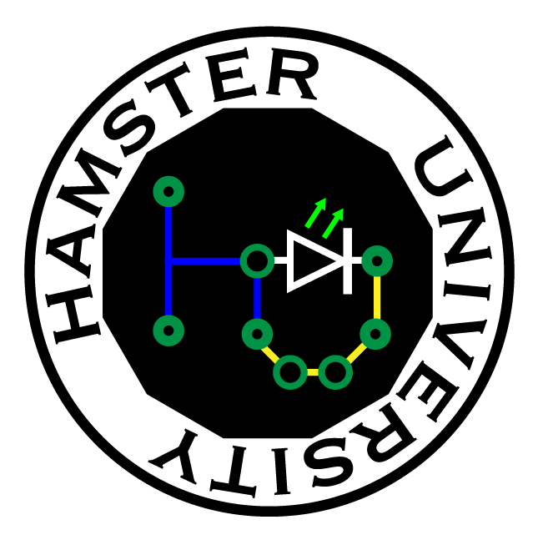
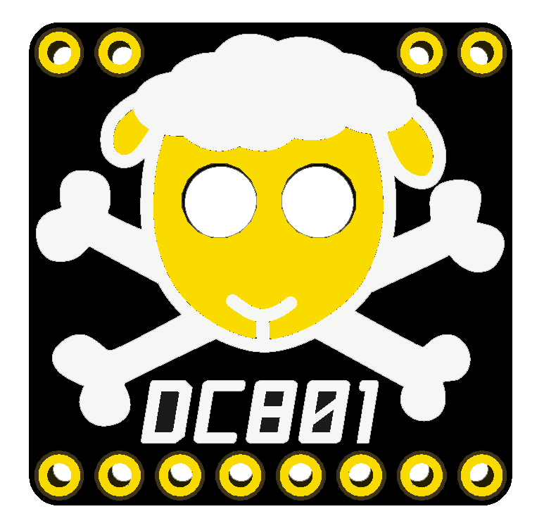
Switch Mode Power Supplies 101

Slide 2
POWER!!!
Almost every device needs power regulation
So how do you regulate power?
SMPS 101

Slide 3
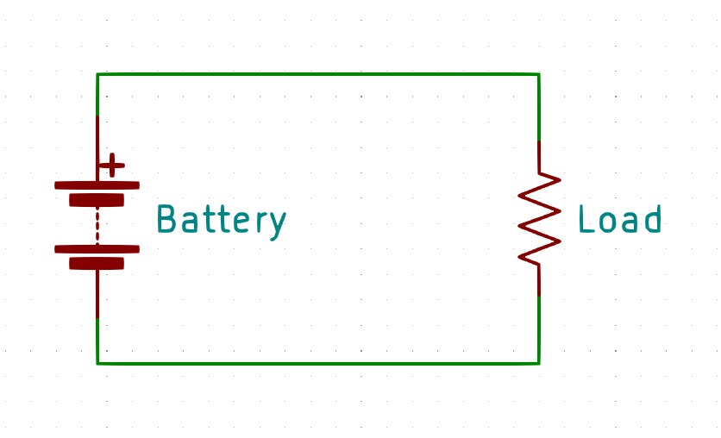
The basic – just a battery
The most basic power supply is none at all
Pick a max battery voltage and use that
Pros – Simple
Cons – No regulation. What happens when the battery discharges?
SMPS 101

Slide 4
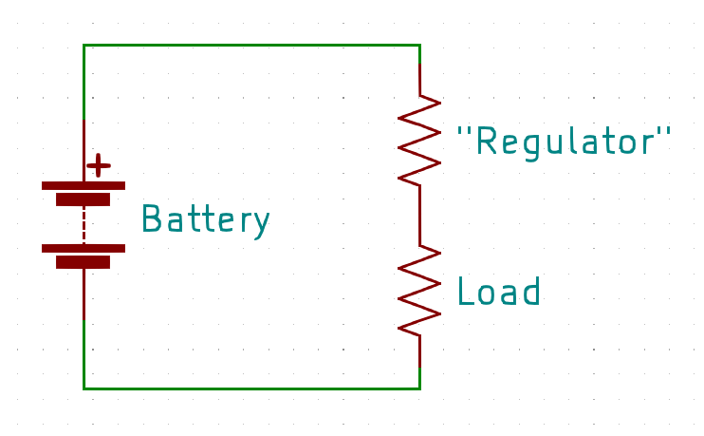
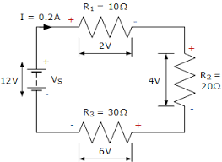
The slightly basic – a resistor regulator
Need a voltage less than that of your battery?
Pick a couple of resistors and use that
Pros – Simple, follows Kirchoff’s Law
Cons – What happens when the battery discharges? What happens if the load resistance changes? What happens if the load is drawing a lot of power?
SMPS 101

Slide 5
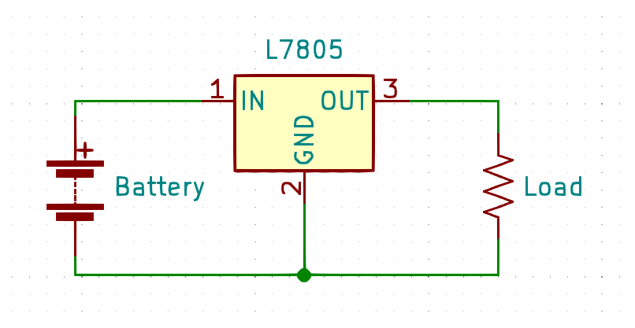
Regulations – a linear regulator
Need an exact voltage?
Grab a linear regulator
Pros – Still simple, cheap
Cons – A linear regulator converts the excess input power into heat! Input voltage must be about 1.5V above what you want out, unless you get a ‘LDO’ (low drop-out), and then 0.3V is typical
SMPS 101

Slide 6
The switch up
So how do we transform voltage efficiently? What if we want MOAR volts out than we have going in? What if we want to go negative?
Introducing the Switch Mode Power Supply!
SMPS 101

Slide 7
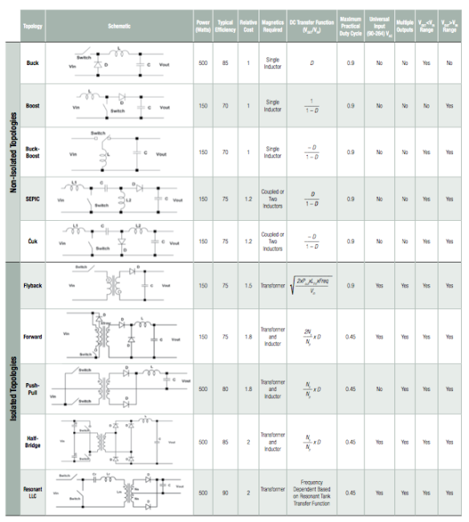
Topologies
SMPS 101

Slide 8
Topologies
… what?
SMPS 101

Slide 9
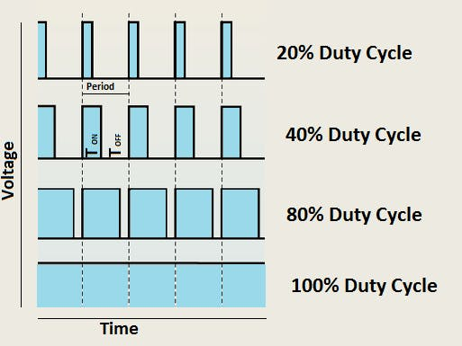
An aside – Pulse Width Modulation
PWM is toggling a switch on and off at varying duty cycle
Duty cycle is expressed in percent on time
Independent of base frequency!
SMPS 101

Slide 10
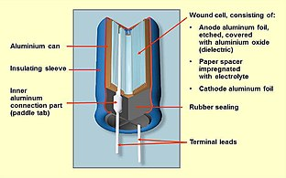
An aside – Capacitors vs Inductors
Capacitor
Stores charge in parallel plates Resists changes in voltage
Measured in Farads – 1 Farad = 1 coulomb at 1 volt
SMPS 101

Slide 11
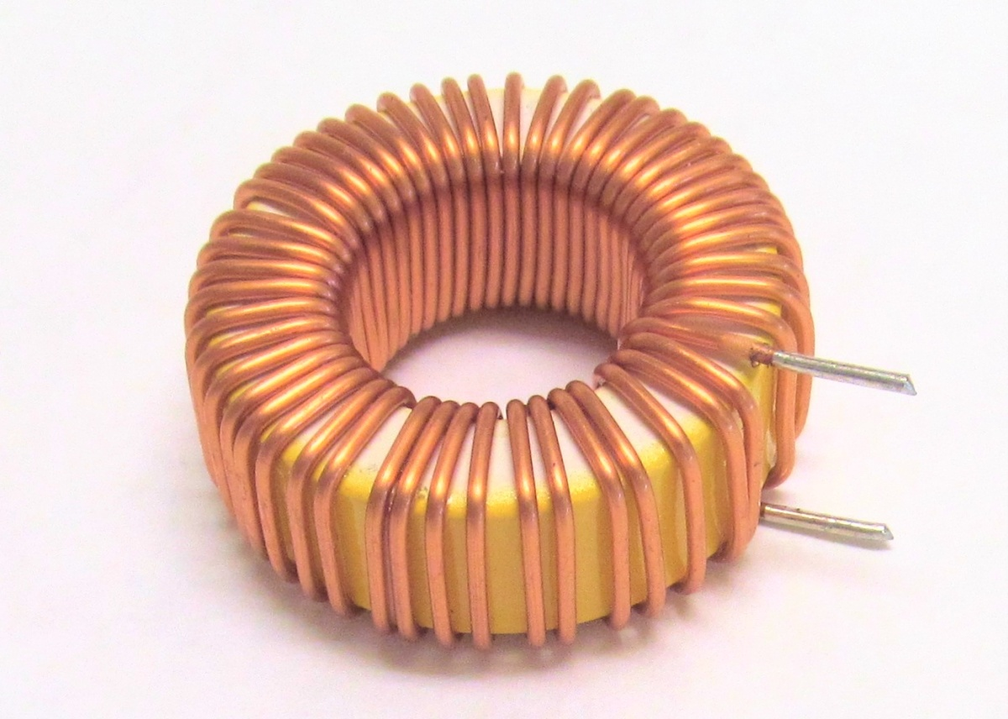
An aside – Capacitors vs Inductors
Inductor
Stores magnetic field in coil Resists changes in current
Measured in Henry – 1 Henry = 1 ampere flowing through the coil producing flux linkage of 1 weber turn (what)
‘Saturation’ is when the magnetic field is no longer rising
SMPS 101

Slide 12
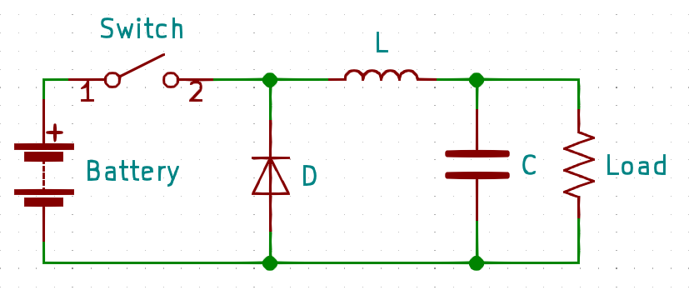
Buck converter topology
Parts:
- A switch - A diode - An inductor - A capacitor
SMPS 101

Slide 13
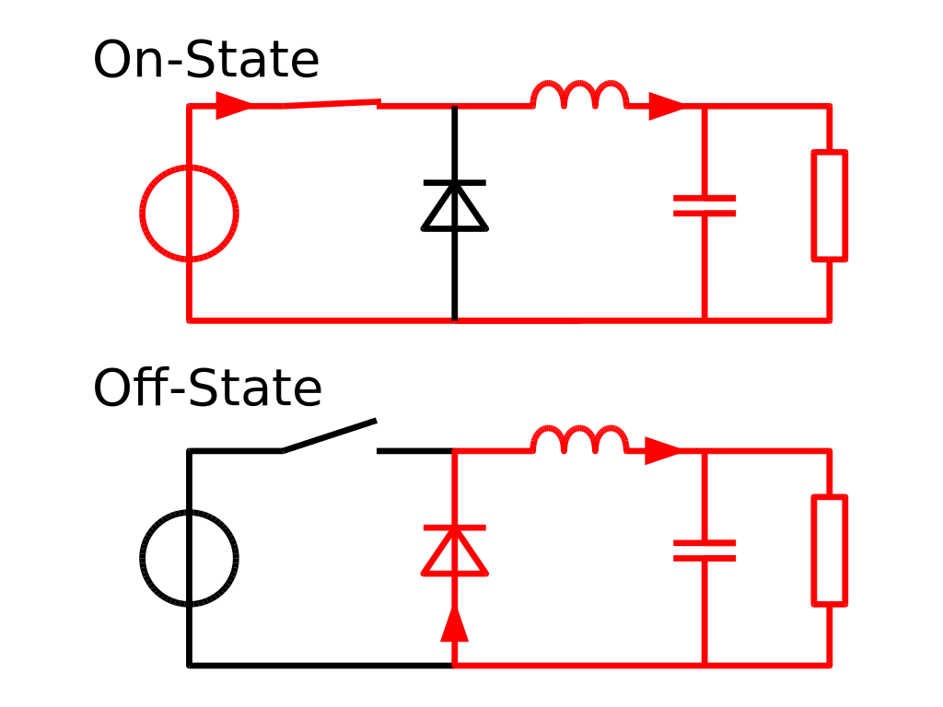
Buck converter operation
Theory of operation
Only want some of the power? Just sip from the firehose!
On State – Directly connected to load. As soon as the output voltage hits the limit, turn it off.
Off State – The capacitor ‘tanks’ voltage, the inductor ‘tanks’ current – for a short while
The diode keeps current flowing in the right direction
SMPS 101

Slide 14
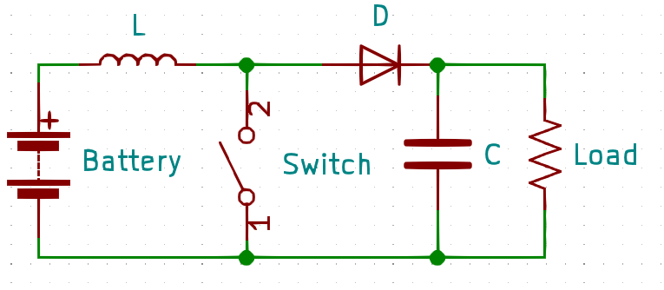
Boost converter topology
Same parts as the buck
New exciting wiring configuration
SMPS 101

Slide 15
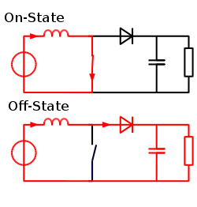
Boost converter operation
Theory of operation
Make the inductor work for you
On State – Short-circuit input into coil to build magnetic field (be mindful of saturation!)
Off State – The inductor tries to keep the current stable by increasing output voltage. The diode steers the ‘boosted’ voltage into the capacitor ‘tank’
No load = output voltage going to the moon
SMPS 101

Slide 16
Other topologies
Buck/Boost – a bit of both
Ćuk – (chook) a Buck/Boost but negative output
Flyback – Isolation of input/output via transformer
Many, many variations…
SMPS 101

Slide 17
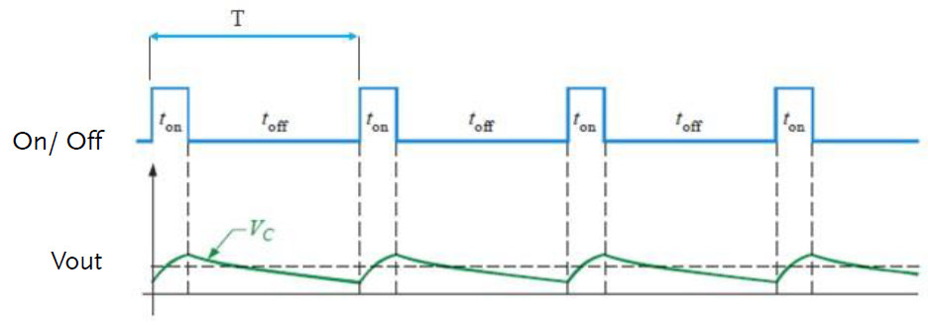
Output Ripple
Ripple in output
More output C, lower ripple
Faster switch, smaller bites, lower ripple
High frequency can generate RF noise, or mess with clocks on your microcontroller
SMPS 101

Slide 18
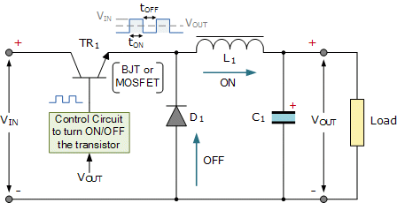
Control
Switch is actually a transistor (surprise!)
Controller can be ‘open loop’ or ‘closed loop’
Open loop is not common
SMPS 101

Slide 19
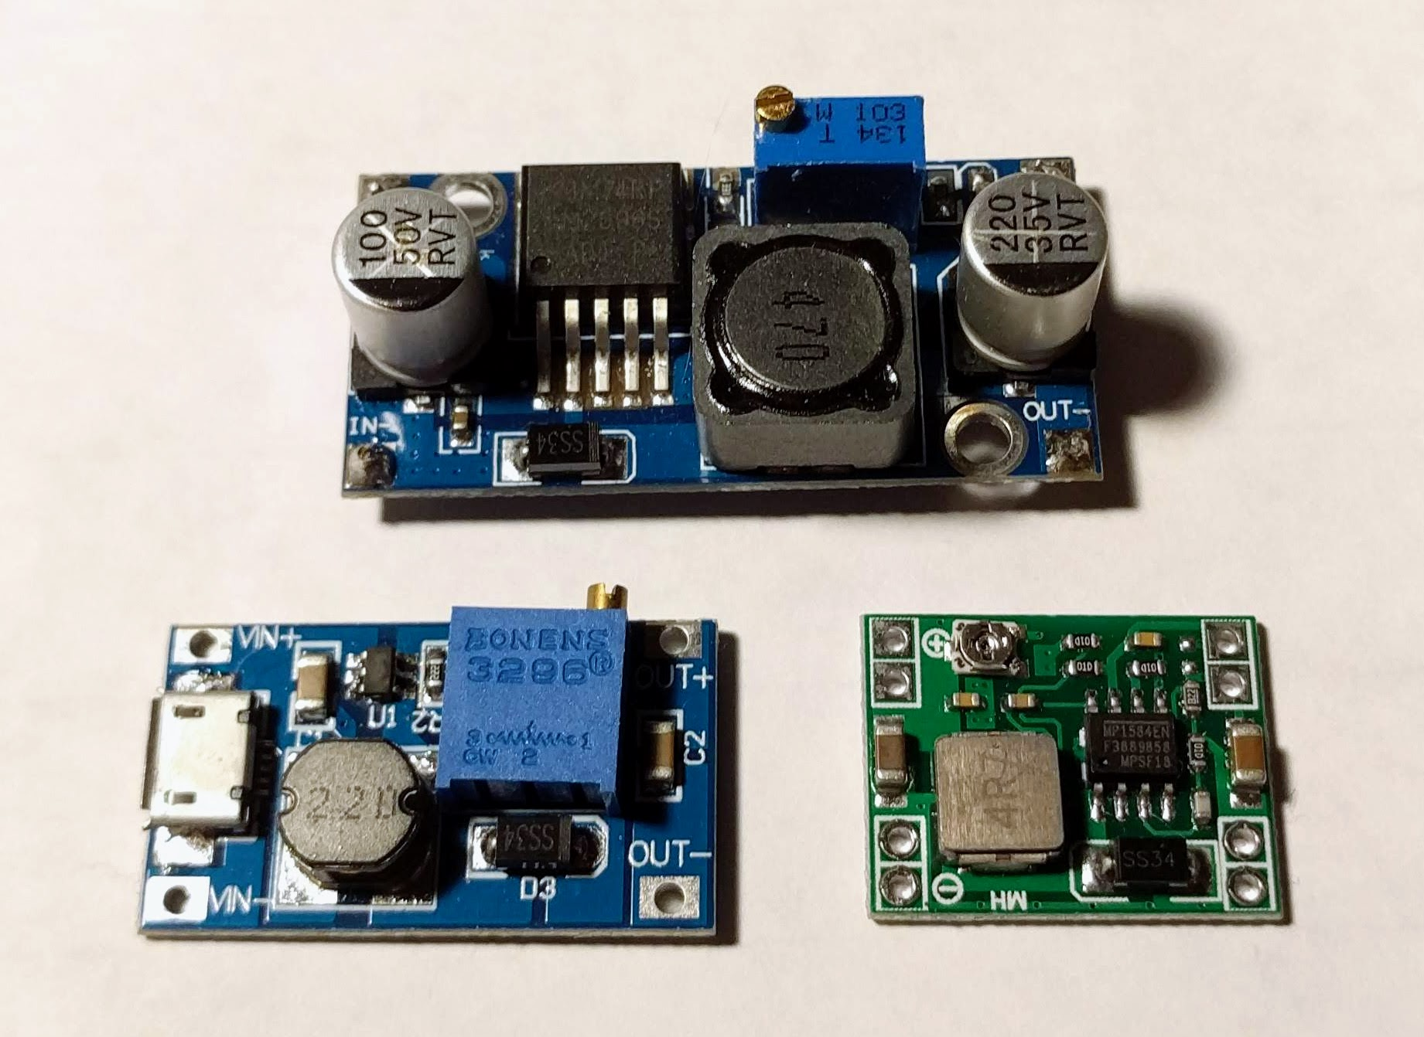
Control
Controller can be a dedicated chip
Or a 555 timer with a feedback element
Or a microcontroller
Or a monkey with a push button
SMPS 101

Slide 20
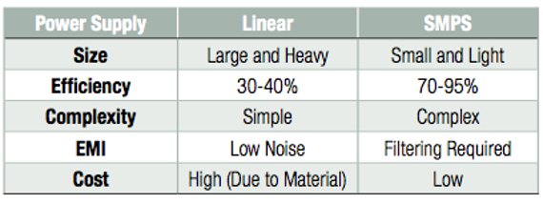
Efficiency
SMPS 101

Slide 21
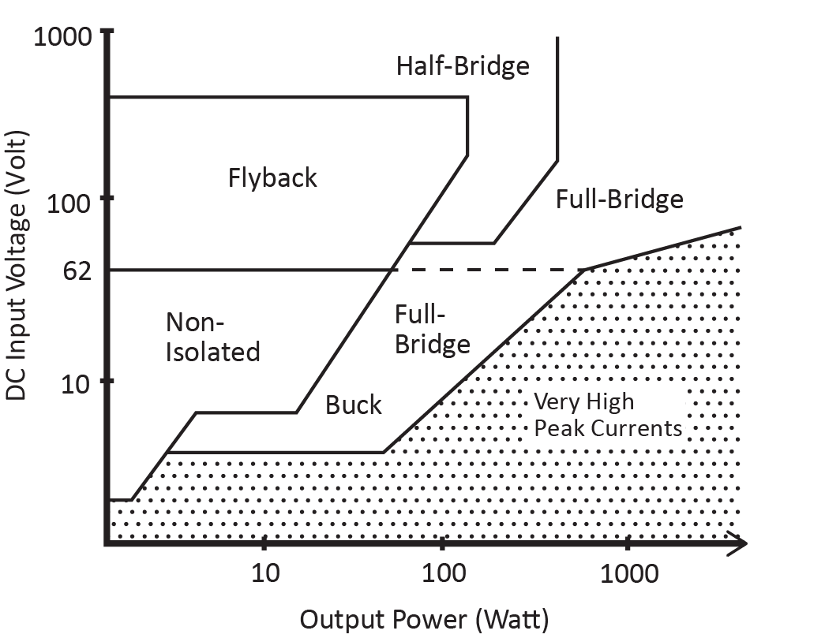
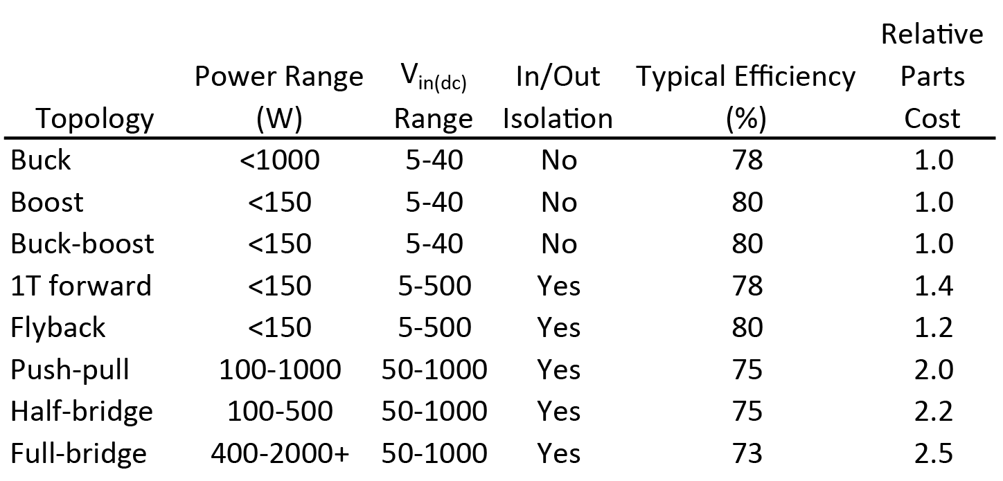
Topology selection guide
https://electronics.stackexchange.com/questions/299435/pros-and-cons-between-smps-switched-mode-power-supply-and-heavy-line-frequency-t
SMPS 101

Slide 22
Questions?
@hamster
github.com/hamster/classroom
SMPS 101

